Slide 1

Guide To Eating And Exercising Right
By: James Loesch

Slide 2

Introduction
Many people struggle with getting to the gym and eating right
They complain that they don’t have enough time to do everything
This little summary gives you the ability to schedule and do everything you want to do
It consists of what diets to use, how to plan a sleep schedule, and what workouts to do in the gym

Slide 3

How to get healthy and feeling better about yourself
Getting at least 8 hours of sleep
Working out or exercising at least three times a week
Having a diet that suits your habits and daily living

Slide 4
Getting a Schedule put together
This will aid in getting the right amount of sleep at night
Help you to organize all the things that you need to get done
Gives you a chance to schedule some lazy time for yourself here and there
Can tell you when you should be eating all your meals for the day
Decreases the amount of stress throughout the day

Slide 5
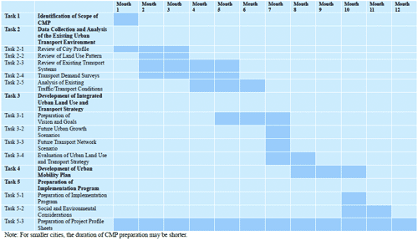
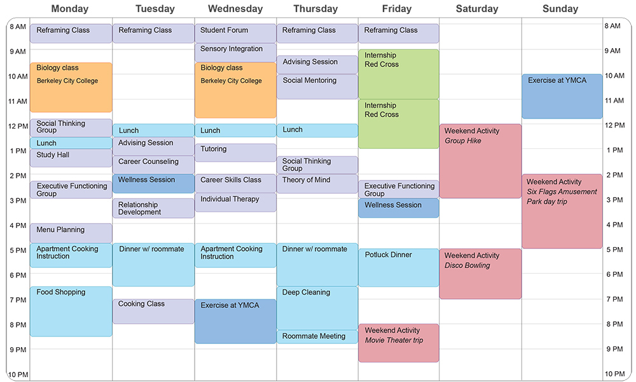
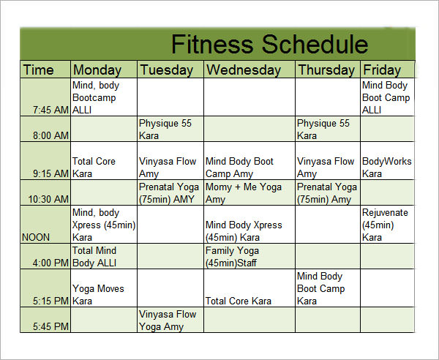
Some example of schedules

Slide 6
Examples of schedules cont.
As you can see in the image to the left that schedule gives you an understanding of a college person living on their own everyday life
In the middle image in the bottom right corner that is giving you an idea of a fitness schedule to get yourself out and exercising.
The image on the right is a month to month schedule of someone trying to complete a different task each month

Slide 7

Exercising
The type of exercising you should be doing is based on who you are and whether you want to lose weight or gain weight
If you want to lose weight, doing high intensity interval training and cardio are your best bests
If you want to gain weight, working on building muscle is what is going to get you where you need to be.
You are able to do much more weights and cardio when you are younger
But when you are older you are better off doing weight barring exercises and calisthenics

Slide 8

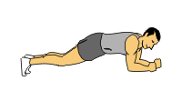
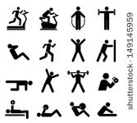
Exercising Cont.
Some high intensity interval training consists of box jumps, then going right into Russian twists, finishing with battle ropes. While maintaining 10 second rest in between to get the heart rate up
Examples of strength training exercises could be like squats, bench press, bicep curls, leg press. Exercises that use more than more muscles to produce force.
Some weight barring exercises and calisthenics consists of push ups, weight barring squats, sit ups, and planks.

Slide 9
Diets
Many Americans struggle with diets, hence why the united states is the number 1 country for obesity
There are many plans that are out there involving high card diets, and low carb high fat diets
Depending on how your life runs can determine what kind of diet you should be following
Someone with an office job may want to have a high fat low carb diet since they don’t really need as much energy as maybe a construction worker or kitchen cook.

Slide 10
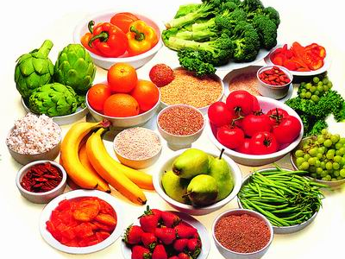
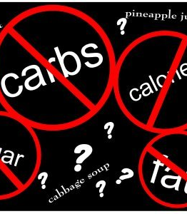
Diets Cont.
A low carb high fat diet that has been very popular in the last year is the Keto diet. With this diet your body is able to go into ketosis and burn more fat than carbs.
With a low fat diet you are eating less calories throughout the day but are getting the certain types of foods to give you energy.
In my opinion you should just follow the RDA recommendations and just do a caloric deficit diet.
This Photo by Unknown Author is licensed under CC BY-NC-ND

